Slide 1
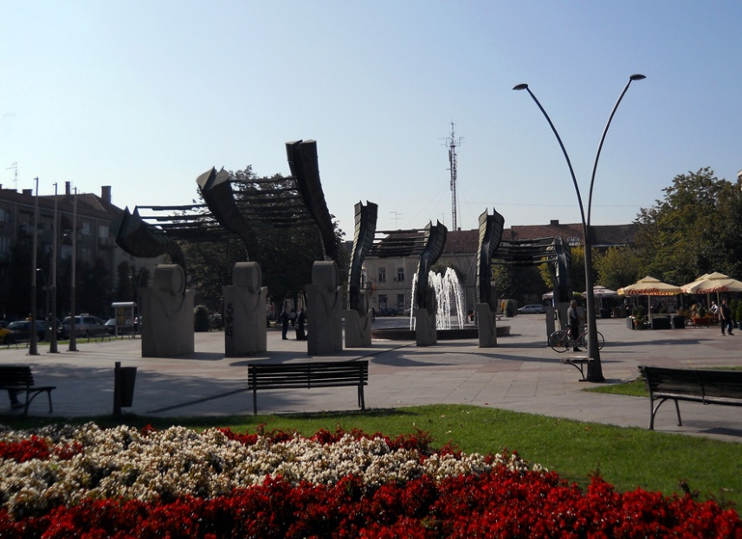


Ruma
Existing resources and investment potentials

Slide 2
VISION OF THE MUNICIPALITY OF RUMA 2030
Ruma is a devoleped regional center of Srem, which in a sustainable way uses the available recourses to achieve economic development and creates favorable connditions for doing business and investing.
Our municipality also represents:
An environment in which satisfied and safe citizens live, who are enabled to participate in all aspects of social life.
An environment where residents have equal access to qualita education, health, cultural and sports facilities.
An environment characterized by an efficient administration than recognizes the needs of its citizens.
An environment that has an inclusive social protection system in place.
An environment that is favorable for the life of the younger and older population.
The municipality of Ruma takes special care of its natural potentials and evnironment, with developed communal and other infrastructure, which provides its citizens with access to clean water, clean air and preserved greenery.

Slide 3
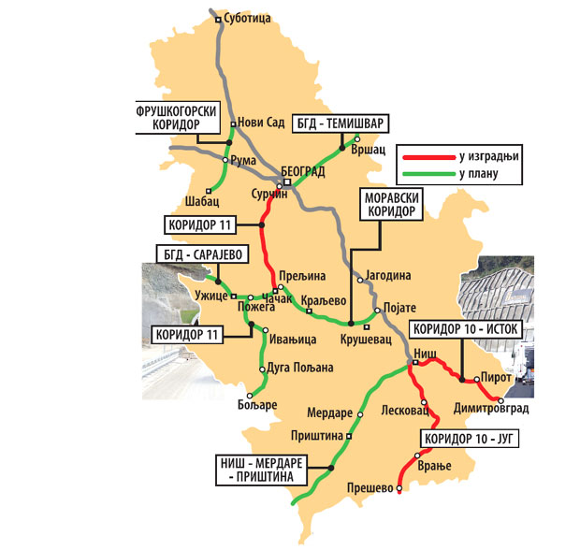
THE MUNICIPALITY OF RUMA
The Municipality of Ruma has an important geostrategic
position. It is situated in the center of Srem district, between
Danube and Sava, at the foothills of Fruška Gora. By its
surface of 582 km², the municipality takes the 13th place in
Vojvodina.
Population: 54,339
Number of communities: 17
Land use: 74% agricultural area, 13% forests, 13% other
Ethnic structure: 21 nationalities
Number of enterprises: 512
Number of entrepreneurs: 1,560
  Key Sectors:
Agriculture
Food processing
Automobile Industry (Automotive Components)
Metal Processing
Chemical Sector

Slide 4

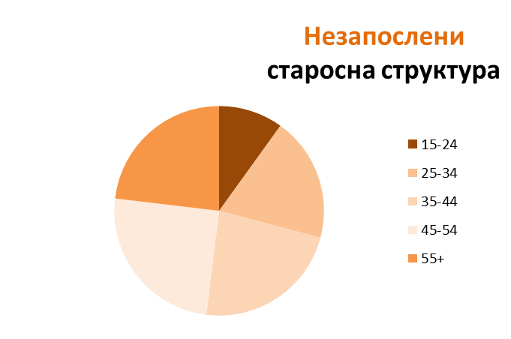



POPULATION
54
UNEMPLOYED AGE STRUCTURE
Number of residents: 54.339
.
2
Workforce
Employed
Total: 17.148
10% | 19% | 23% | 25% | 23%
458 | 886 | 1052 | 1150 | 1066
Unemployed
Total: 2.829
January 2021.
Average age: 42,7
1.489
1.340

Slide 5





WHY INVESTING IN THE MUNICIPALITY OF RUMA?
5 REASONS FOR INVESTING IN RUMA
Exellent strategic location
- close proximity to Belgrade, the international airport, major highways, and main railroads
A good return on investment and optimum cost-benefit
- the qualified workforce at competitive rates, fairly-priced land, and low construction costs
Straightforward construction permit procedures
Extremely attractive industrial locations with direct access to trans-European highway E-70
- 5 industrial zones
A special set of the local government incentives for the investors

Slide 6


BASIC INFORMATION
The main exporting countries | % of total exports
EU | 69,8%
CEFTA | 16,7%
Russia | 6,4 %
GDP, 2017. | 36,832 billions of euros (EUR)
Agreement on eliminating double taxation, signed by 58 countries
The bilateral investment agreement made with 39 countries

Slide 7
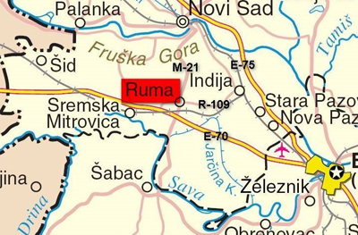
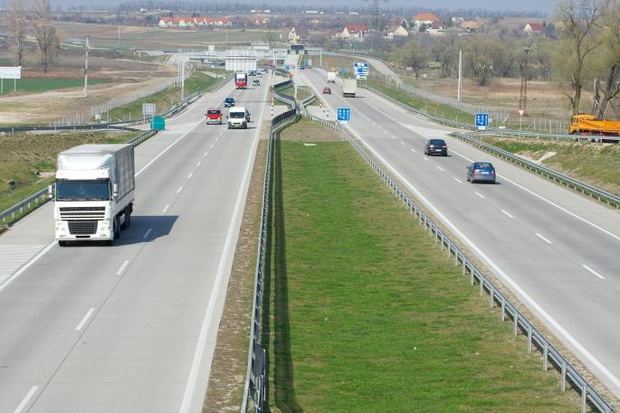
THE INTERSECTION OF MAIN EUROPEAN ROADS
highway Е-70;
the main highway M-21;
railway Belgrade-Zagreb-Vienna (27 км);
vicinity of the harbor in Sremska Мitrovica (15 км);
vicinity of the harbor in Šabac (35 км);
vicinity of the international airport Nikola Тesla (35 км).
Roadway Ruma-Šabac-Loznica
has started with construction in 2019.

Slide 8

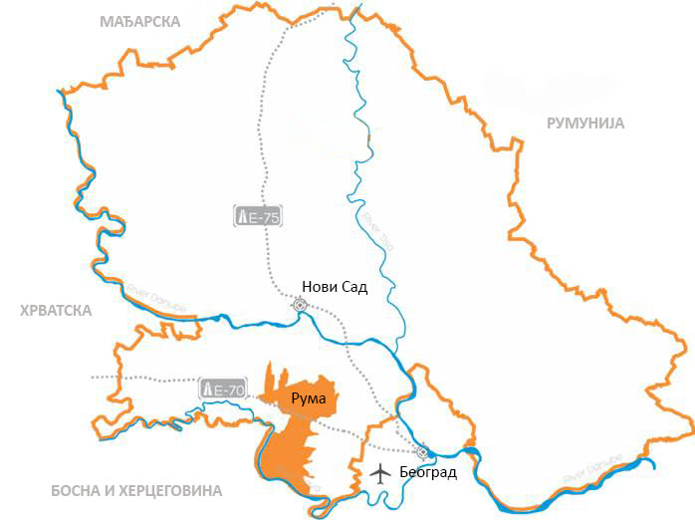



















STRATEGIC POSITION
Ruma- ukupna površina 582 km
Срб
Distance From Borders
HUN
CRO
ROM
BUL
BIH
Река Тиса
Distance From Highway
Река Дунав
Distance From Airport
Река Дунав
Belgrade
Оsijek

Slide 9

High school | Major | #students | #graduates
Middle School (Gymnasium) | General | 198 | 42
 | Humanities and languages | 206 | 52
Specialized | Economics | 164 | 59
 | Finance | 100 | 28
 | Hospitality | 80 | 29
 | Textile | 60 | 22
Agricultural | Horticulture | 8 | 8
 | Environmental protection | 44 | 17
 | Agricultural technician | 38 | 11
 | Veterinarian | 91 | 23
Technical | Computer systems | 61 | 12
 | Motor vehicles | 57 | 10
 | Electricians/Car mechanics | 93 | 35
 | Electro-energy automatics | 12 | 12
 | Electro-energy computers | 97 | 14
Elementary education
Secondary education
Academic education
Vocational education
EDUCATION

Slide 10
INCENTIVES
REPUBLIC | Funds are allocated for investment projects in the area of production and service sectors (international commerce), agriculture, and fishing industry. The allocated funds make up to 50% of the invested funds, based on the investment value or the two-year employees' gross earnings.
PROVINCIAL | System Support | Development agency of Vojvodina Capital Investment Administration of AP Vojvodina Guarantee Fund of AP Vojvodina Development Fund AP Vojvodina
 | Support for developmental economic facilities | Provincial Secretariat for Economy and Tourism Provincial Secretariat for Agriculture, Water Management, and Forestry Provincial Secretariat for Regional Development, Interregional Cooperation, and Local Self-Government
LOCAL GOVERNMENT | Greenfield – a lower price than the market one or free of charge one
 | Local taxes

Slide 11



MUNICIPALITY INCENTIVES & FEES
Account Manager
Appointed to each investor:
* assistance in administrative procedures
* liaison with relevant institutions
Accelerated Procedures
For issuing building permits
* 2 days from submitting the required documentation
Communal Fee
* depending on the number of new employers
Land Price Discounts
* depending on the number of new employers
* price for 5 euro per m²

Slide 12



ENERGETIC POTENTIAL
GAS
ELECTRICITY
Municipality is gaslfied | 100 %
Local Pipeline length | 514 Km
Pressure on main pipeline 6-12 bar Pressure on local pipeline 0-4 bar
No. of distribution substations - 10/x 35/x ; 10(20)/04 | 305
Total Power | 256.310 kVA
Total Network Length
Medium voltage network | 275 Km
Low voltage network | 336 Km
Energy supplied in 2013/14 | 177.572 MWh
Avaliable capaclties 110/x: 94.500 kVA 5/x: 32.000 kVA 10(20)/0.4: 129.810 kVA
FARMLAND
Total Land | 58.206 ha
Agricultural Land | 42.970 ha
Arable Land | 41.764 ha
Most common crops Maize, wheat, soy * Crop residue: 105,000 per year

Slide 13

REVIEW OF TAX RATES
INCOME TAX
PROFIT TAX
VAT – standard rate
Serbia | 10 %
Czech Republic | 15 %
Romania | 16 %
Slovakia | 19-25 %
Poland | 18-32 %
Croatia | 12-40 %
Serbia | 15 %
Romania | 16 %
Poland | 19 %
Czech Republic | 19 %
Croatia | 18 %
Slovakia | 17 %
Serbia | 20 %
Bulgaria | 20 %
Slovakia | 20 %
Czech Republic | 21 %
Poland | 23 %
Croatia | 25 %
5 working days a week – 40 hours per week : (37.5 hours net) 30 minutes break
Vacation Minimum 20 days a year Holidays Non-working days during the year 11-20 | Overtime and night shift 26% bonus on a base salary State holidays 110% bonus on a basic salary | A fixed-term contract Maximum of 2 years Trial period Maximum of 6 months | Minimum monthly earnings NET 229 €
Social contributions:
Pension and disability insurance
Health Insurance
Unemployment Insurance
Annual income tax
Tax on other income
12% 14%
5,15%
0,75%
10-15%
20%

Slide 14



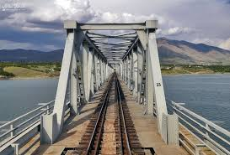



INFRASTRACTURE
ROADS
WATER SUPPLY
Highway E-70 length | 27 Km
Regional road network | 86 Km
Local road network | 119 Km
River Sava length | 30 Km
Port in Sr. Mitrovica distance - 16 Km Port in Šabac distance - 36 Km
Irrigation/drainage network | 1.109 hectares
SEWAGE SYSTEM
Sewage system | 100 %
Sewage network | 100 Km
* Water purlfier in use
RAILWAY
Railway network length Belgrade - Zagreb - Viena | 27 Km
Axial pressure | 22,5 t

Slide 15


CONSTRUCTION PERMIT PROCEDURE
Laying down the location conditions for the cadaster parcel suitable for construction - since the day of obtaining all specific terms, permits, and other documents.
Phases & Timeline
Upon receiving an investor’s request, the consolidated construction permit procedures are conducted in the following phases.
In total: 28 working days
Working days
5
No Later than:
Based on construction work registration, issuing the verification for the application receiving without delay, verifying that the complete documentation has been submitted.*/**
Granting the construction permits - since the day of the request submission.
Working days
5
No Later than:
Working days
Upon receiving the application.
5
No Later than:
Working days
Granting the final approval upon receiving the submitted request.
3
No Later than:
Working days
5
No Later than:
Working days
Registering in the cadaster.
5
No Later than:
Working days

Slide 16
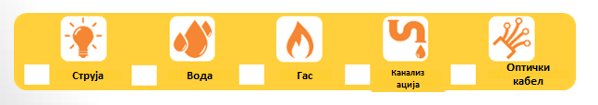

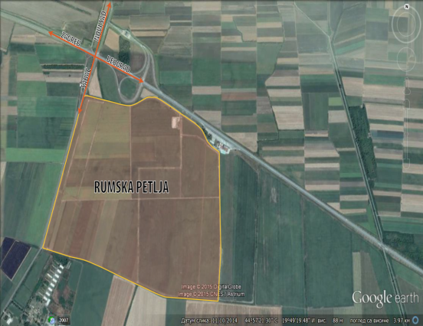
GREENFIELD LOCATIONS
Location 2
Blok 2-11-2
Surface land : 17414м2
Location 1
Industrial zone Rumska petlja
Surface area : 238 hа
Available : 153 hа
Individual lots : 1-50 hа
Purpose : industrial
Property : municipality
Description:
*close to Highway-70 and railway
*plan to make sewage sistem
Present companies
Capital group Doo
HealthCare Europe
CG Food Europe
Rumekon Doo
Srbijaautoput
Location 3
Rumska petlja “West”
Surface land : 767199м2
Location 4
Blok 4-15-1
Surface land : 38099м2
Surface of objects : 3287м2
Location 5
Work zone Putinci
Surface land : 564300м2
Location 6
Work zone South 2
Surface land : 983.589 м2
Surface of objects : 2628 м2
Location 7
Work zone East 2
Surface area : 40.379 м2
sale
rent

Slide 17
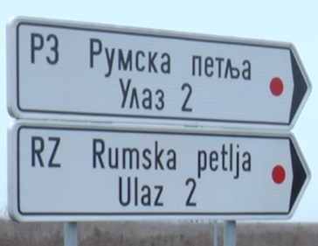
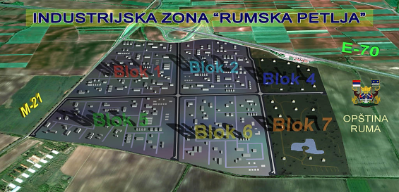
Work zone
RUMSKA PETLJA
238 ha
Intersection of roads: Е-70 highway Belgrade-Zagreb
and the first class state road M21 Novi Sad-Šabac
Parcels size from 1 ha to 50 ha
Electric power network 14 MW (there is a possibility for connection to the transmission line 20 kB)
Magistral water supply network located 250m from the
parcels, capacity 200 l/per second
Gas network
Access roads
Public lighting

Slide 18
Rules and conditions for planning and building on construction plots in blok 1 of the work zone Rumska petlja
Within the work zone "Rumska petlja", in block number 1, construction plots can be formed - potential locations for construction of work complexes, with areas from 1.5 to 5.1 ha.
From existing plots, it is possible to form new construction plots, all by the parameters set out in the plan.
On the building plot, it is possible to build production storage facilities and supporting facilities that operate as well as facilities for infrastructure purposes.
Secondary and tertiary activities are permitted as well as various service activities
Construction of a waste storage facility as a facility where the activity of storage of waste and treatment and disposal/disposal facilities for hazardous waste, as well as underground reservoirs, is prohibited, due to the proximity of the source
The occupancy index on the plot is 50% and the construction index is 2.0.
Maximum number of production, processing and auxiliary facilities is P + 0, galleries are possible, exceptionally P + 1 if technology requires it.
For buildings for administration and similar purposes, the maximum number of floors is P + 3, but the height of the building does not exceed the height of 16.0 m.

Slide 19


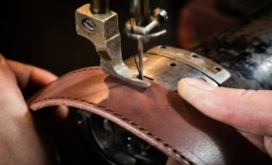


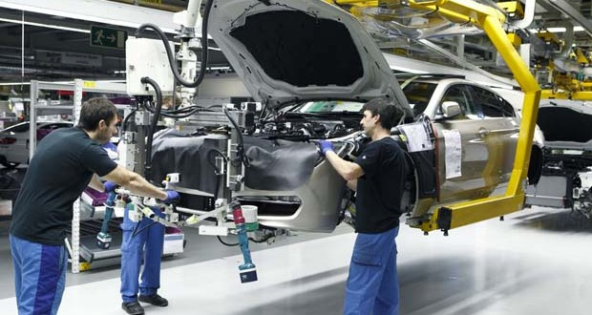
KEY SECTORS
Opportunities for investment
AGRIBSINSS
Leather and footwear
industry
TOURISM
TOURISM
CHEMCAL INDUSTRY
Agribusiness
Textile industry
ICT
CONSTRUCTION
TOURISM
METAL PROCESSING
LOGISTIC CENTER
Automotive industry
Tire industry

Slide 20
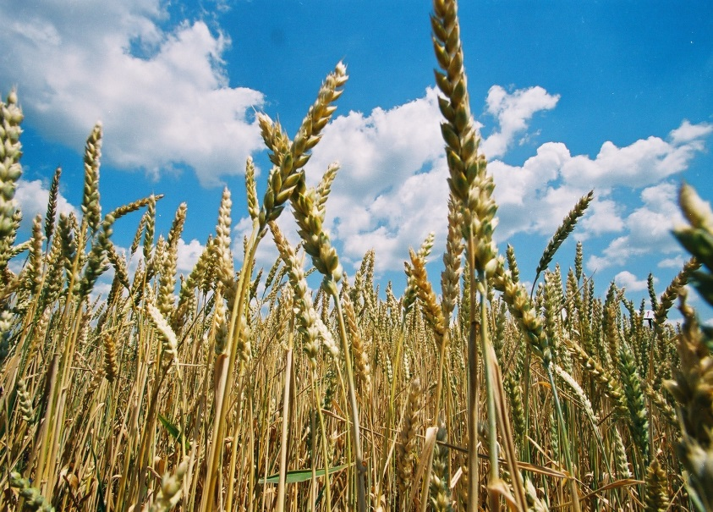
AGRIBUSINESS
41.000 ha of fertile arable land
Main advantages:
Arable land 41,700 ha; Pastures 720 ha; Orchards 691 ha; Meadows 245 ha; Vineyards 183 ha; Gardens 10 ha.
A wide network of potential local suppliers: 7000 small farms – a number of agricultural cooperatives.
Agri-association: promoting & implementing E-agriculture.
Grain storage capacities: 71,500 t.
Agricultural high-school: a continuous supply of an educated workforce.
Investment opportunities: Fruit & Vegetable processing, Meat & Dairy production.
Arable land 41.000 hа
maize | 51 % | vegetables | 3 % | sunflower | 3 %
wheat | 21 % | fodder | 1 % | tobacco | 1 %
soy | 8 % | sugar beet | 0,7 % | barley | 0,7 %
Livestock count
cows | 1.207 | sheep | 4.962 | poultry | 224.758
cattle | 5.024 | goat | 1.783 | brоilers | 146.000
sows | 5.305 | pigs | 61.310 | hens | 42.798

Slide 21
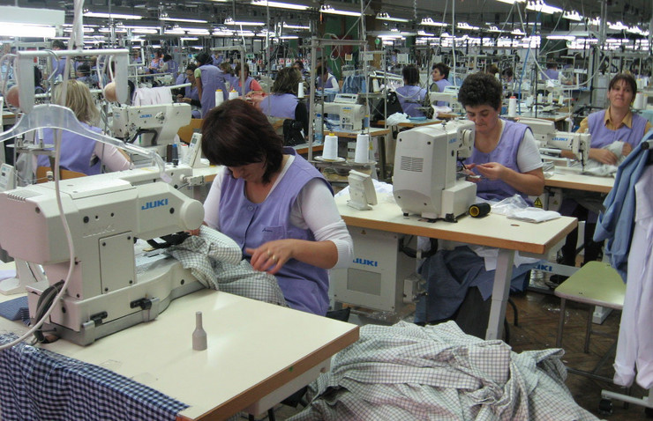
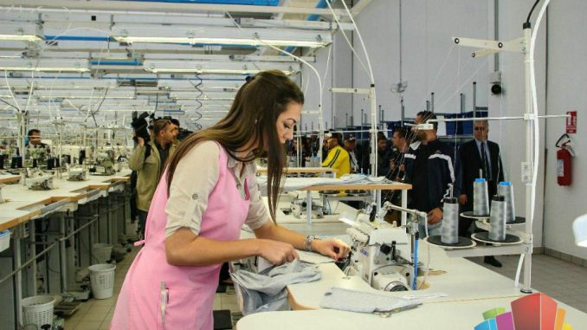
TEXTILE INDUSTRY AND LEATHER AND FOOT
INDUSTRY
Half-century tradition
Main advantages :
Skilled workforce at competitive rates
Textile high-school – a constant influx of qualified workers
Reputable companies with a long-established tradition
Leather Factory Ruma - leather processing since 1936;
Footwear Factory Fruska Gora - footwear production since 1948;
Apparel Factory Kluz - Srem - apparel production since 1947.
Companies and partners:
Adriana Tex – swimwear (Italy/Croatia)
Falco East – children's footwear (Italy)
Dag-Co – leather (Serbia)
Luxury Tannery – fur and leather (Italy/France)
HealthCare Europe – memory foam (China/Denmark)

Slide 22
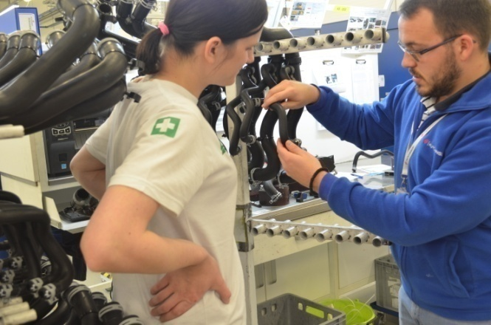

AUTOMOTIVE COMPONENTS
Ideal strategic position
MAIN ADVANTAGES :
A popular choice for foreign companies dealing in automotive component manufacture
Technical high-school - supplying the companies with highly-skilled workers, fulfilling the industry standards
Great potential for export-oriented production since FTAs and perfect strategic position enabling international commerce, logistics, and supply chain
Full and ongoing support for investors and key sectors
A vast number of successful foreign companies:
ALBON - manufacture of turbines, electric motors, generators (UK)
MITAS TRELLEBORG- production of tires for agriculture machines (Czech Republic)
HUTCHINSON - rubber hoses for liquids in car engines (France)
Land ownership:
municipal

Slide 23
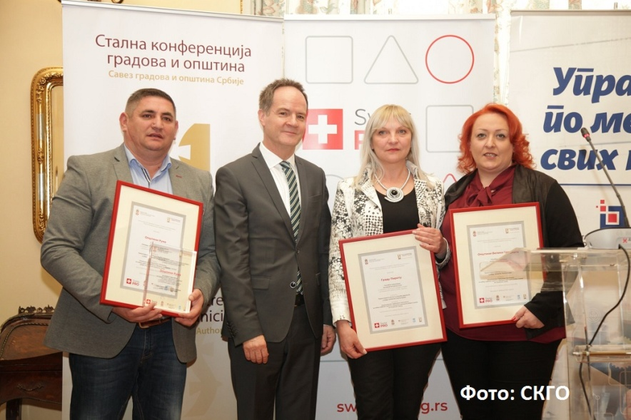
THE BEST WORKING PRACTICES
The effectiveness of local government in granting construction permits is a great example of the best business practice. The Municipality of Ruma has received a large number of requests for construction permits that are responded to quickly and positively.
The award was presented by the Ministry of State Administration and Local Self-Government, and the Standing Conference of Towns and Municipalities - Association of Cities and Municipalities of Serbia (SCTM) as a part of the project "Improving good governance at the local level."
The Commission for the election of best practices in the area of good governance principles implementation at the local level has made the decision on the winner award for cities, communities, and municipalities that contributed the most to the development and implementation of good governance principles within their territory in 2018.
In the section of "Transparency and Public Participation in the Work of Local Self-Government", the Municipality of Ruma won the first prize.

Slide 24













FOREIGN COMPANIES IN RUMA

Slide 25

TOP 15 Employers
Companies | Country | Number of employees (january 2021.)
HEALTHCARE EUROPE | China-Denmark | 1100
HUTCHINSON | France | 841
MITAS - TRELLEBORG | Sweden | 580
DAG-CO | Serbia | 355
CABLEX-S | Slovenia | 320
SELIA | Serbia | 200
CALZEDONIA | Italy | 225
FALC EAST | Italy | 265
ALBON | United Kingdom | 255
LUXURY TANNERY | France | 184
FRIGO ŽIKA | Serbia | 215
WAI WAI (CG Food Europe) | Nepal | 227
MATIS MEBL | Serbia | 120
ANDRIJAŠEVIĆ | Serbia | 86
RUMEKON | Serbia | 70
UKUPNO: |  | 5043

Slide 26

Your partner in Ruma
Thank You For
Your Attention
The Municipality of Ruma
Glavna 155, Ruma
Department for local and economic development
ruma.razvoj@gmail.com
www.ruma.rs

